Slide 1









My Algebra Interactive Notebook
$$×$$
$$\frac{1}{2}$$
$$÷$$
$$+$$
$$−$$
$$\frac{3}{5}$$
$$7$$
Name
Class
Teacher
Term 1 Semester 1
$$5^{2}$$
$$\sqrt{9}$$
1

Slide 2
Contents
Glossary or Formula Page
Page
Date
Description
2
3

Slide 3
Tasks
24
7
30
Essential Question
Questions
Notes
Summary
6
7

Slide 4
24
7
30
Date
Simplify Algebraic Products & Quotients
EQ – How do I Simplify Algebraic Products & Quotients?
7

Slide 5
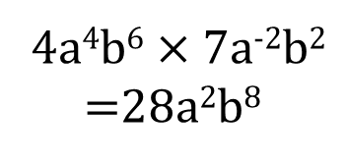

24
7
30
Date
Simplify Algebraic Products & Quotients
EQ – How do I Simplify Algebraic Products & Quotients?
Product?
$$5a2 ×−2a$$
=-10a³
Don’t forget a –ve times a +ve is a -ve
We add the indices and multiply the numbers
4a⁴b⁶ $×$ 7a⁻²b²
=28a²b⁸
Quotient?
14a⁶ ÷ 2a³
=7a³
We take the indices and divide the numbers
16a⁻³ b⁵ ÷ -4a³b⁻⁴
=-4a⁻⁶b⁹

Slide 6
Exercises
Exercise 1.5 and 1.6 from Dwyer
All to be done with a smile on your faces.

Slide 7
Notes Review
24, 7 ,30
Date
Title
Essential question
Notes complete
Notes complete with colour and diagrams
Questions completed
Contents page filed in
Formula page filled in

Slide 8
Homework
Review your notes and write a summary answering the essential question.

